Slide 1
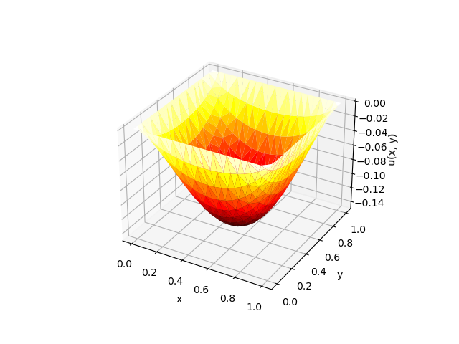
Vector differentiation
Nazmul Kader Chowdhury
B.sc, M.sc (Applied Mathematics)

Slide 2
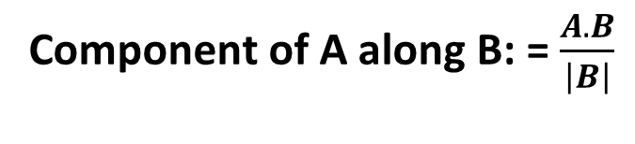
What is component?
Component of A along B: = $\frac{A.B}{\left|B\right|}$

Slide 4
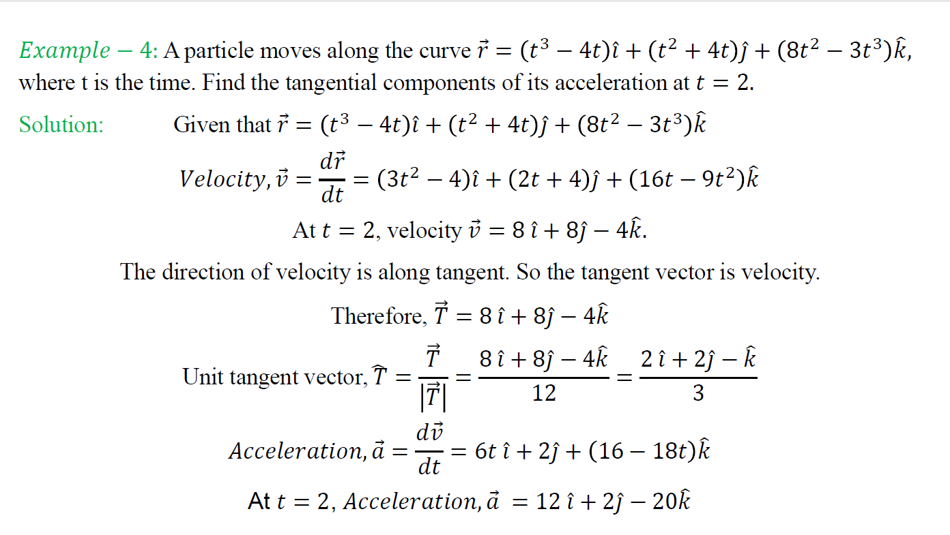

Slide 5
